Slide 1



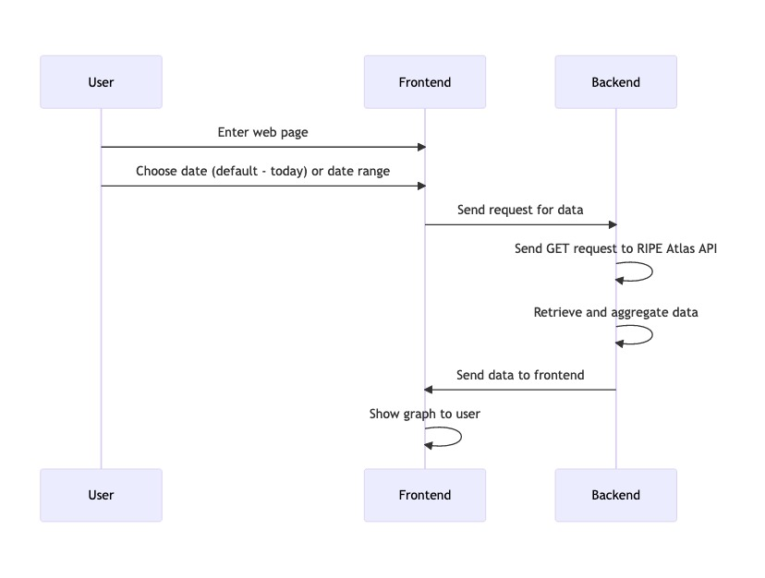
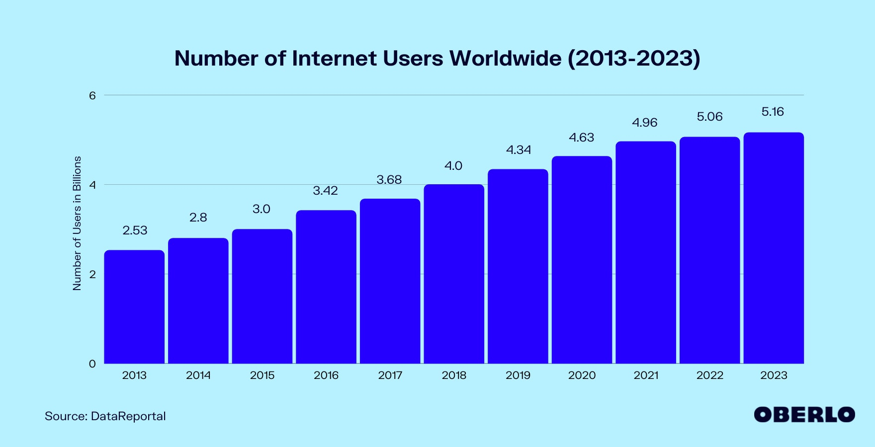
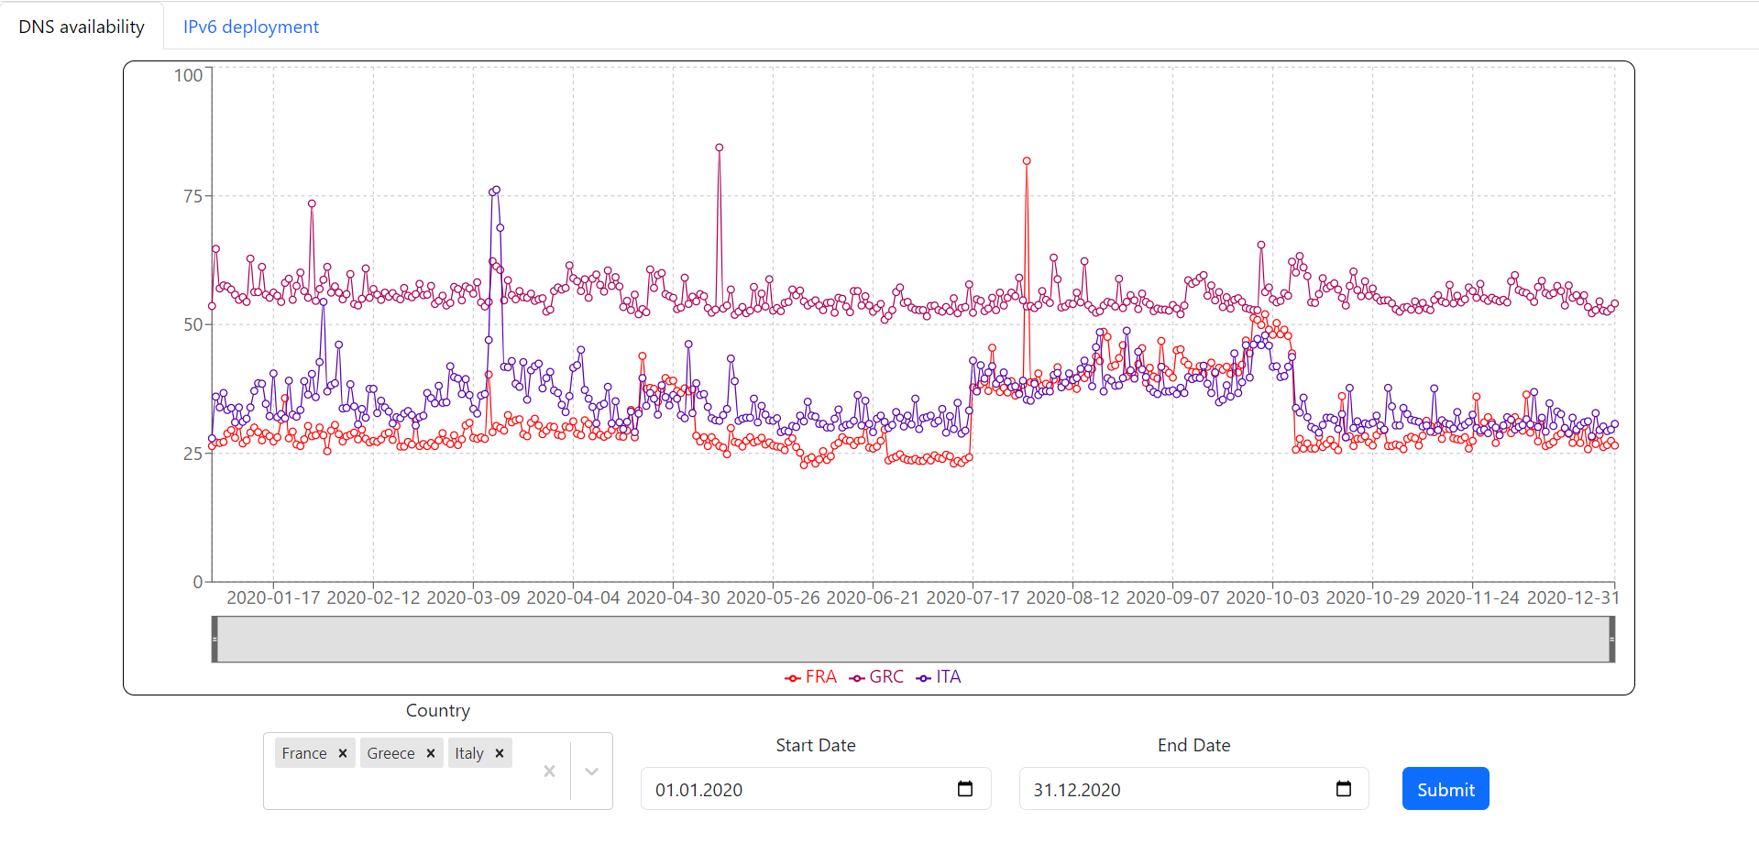
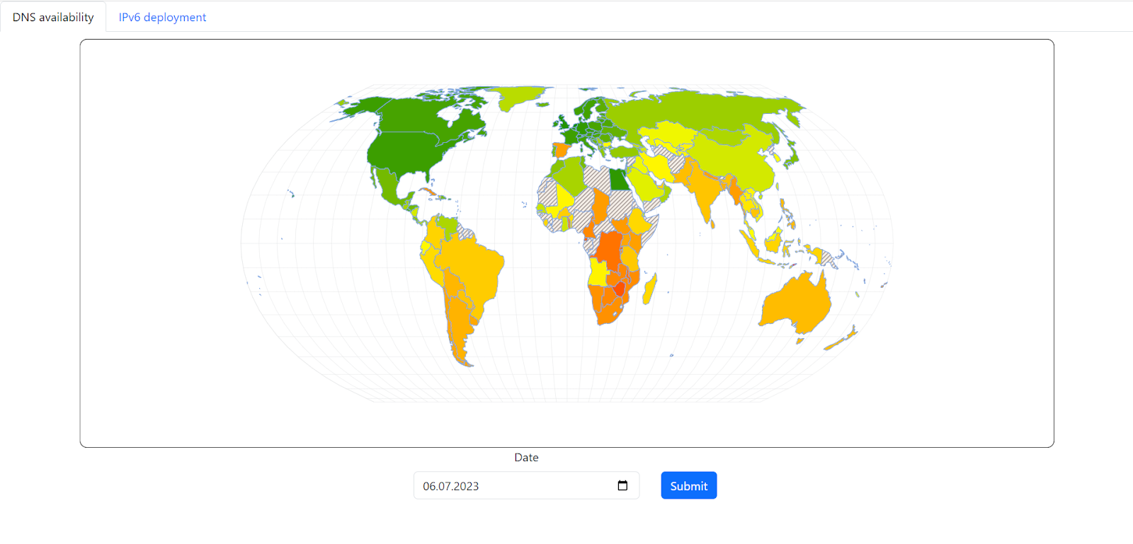
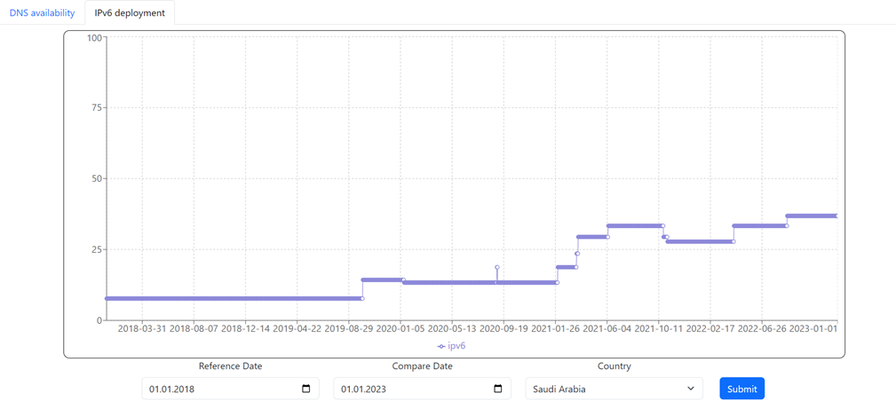
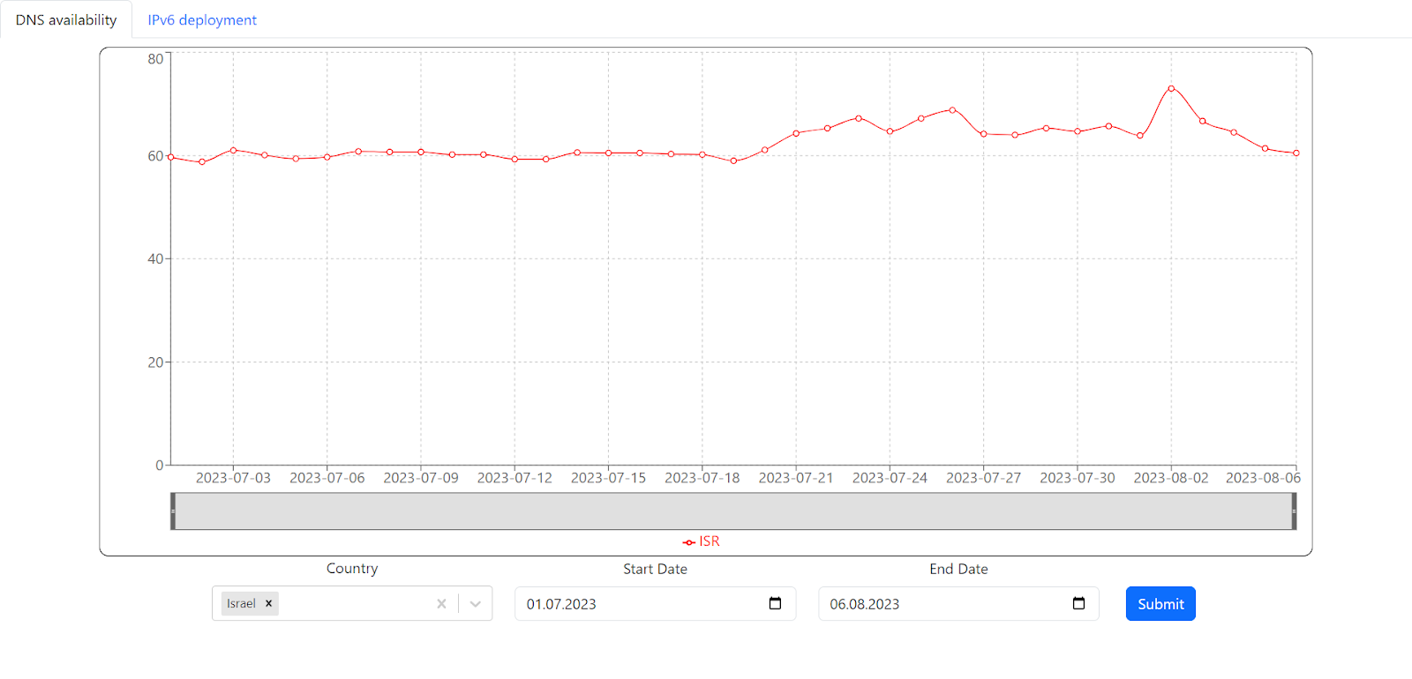
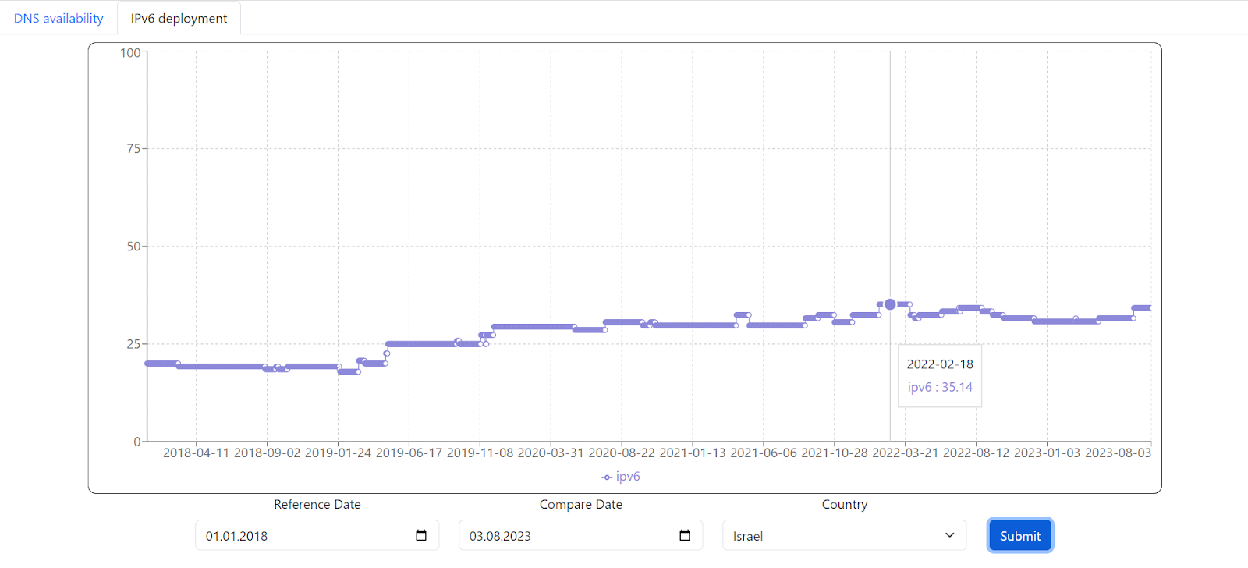
Ripe Atlas
Internet communication analysis tool
Maxim Yadoshlivyy and Daria Levitan
Introduction
System Architecture
Changes in DNS stability due to COVID -19
The Internet is a complex and dynamic network, whose performance is constantly changing depending on various factors, such as the nature of communication usage, malfunctions, cyber attacks, political events, and more. Measuring the performance of the internet network makes it possible to analyze its behavior and normality, and also makes it possible to learn about various events that affected the network's behavior.
We anticipated observing an increase in RTT to DNS during quarantine, a trend that materialized in certain countries such as Italy and Germany. However, this pattern was not universally evident, owing to factors like probe density, local variations, political dynamics, and network intricacies.
The system is built from 3 main parts:
Ripe Atlas - measurements database.
Django – a web server that will serve the GUI as API, and will encapsulate the ripe atlas API calls for the front end.
React - frontend that will show the GUI to the user.
All the system runs on localhost, with no need for any external infrastructure. Users only need to run a server and open the web page.
Goals
Design a user-friendly GUI to facilitate statistical analysis of global network changes in response to various world events and global transformations.
Conduct an in-depth investigation into the specific impact of the COVID-19 pandemic on the evolution of networks worldwide.
Growth of ASes using IPv6 due to COVID-19
Challenges
Our anticipation of observing an increase in IPv6 ASes post the onset of the COVID-19 pandemic was grounded in the belief that governments would allocate more resources to bolster internet infrastructure, given its heightened importance in people's lives. Particularly noteworthy are the substantial gains witnessed in the United Arab Emirates and Saudi Arabia, where the percentage of ASes with IPv6 witnessed remarkable growth, with UAE experiencing an increase from 11.11% on 01/01/2018 to 41.67% on 01/01/2023, and Saudi Arabia experiencing growth from 7.69% on 01/01/2018 to 36.84% on 01/01/2023.
Rest API limitations - the API response was limited to a maximum of 100 objects, presenting a potential roadblock to comprehensive data retrieval. In response, we devised a strategy to overcome this limitation.
Django and React integration challenges - Issues arose around serving static files, especially when it came to the Webpack-built React components being served by Django's static files system. We overcame this by setting up Django to serve only the API endpoints using the Django Rest Framework (DRF) while letting React handle all the frontend routes and views.
React state management complexity - We initially used local component states, but as components began to share and require more interrelated data, our states became dispersed, leading to convoluted prop-drilling and unexpected behaviors. The solution came in the form of integrating state management libraries like React-Hooks instead of React class-based design.
User-system interaction
One day average RTT to DNS for all countries
Ripe Atlas
RTT to DNS for one or several countries for a period of time
Conclusions
RIPE Atlas is a global network of probes that measure Internet connectivity and reachability, providing an unprecedented understanding of the state of the Internet in real-time.
Probes are dispersed devices conducting diverse measurements, while anchors enhance measurement capabilities.
Measurements encompass connectivity, performance, security, and infrastructure analysis, aiding researchers and operators in troubleshooting, vulnerability identification, and optimization.
This project leverages RIPE Atlas data to uncover significant shifts in network behavior during the COVID-19 pandemic, revealing increased IPv6 Adoption and ASes in developing countries. The platform's intuitive visualization and analysis framework lays a strong foundation for future tools, empowering researchers and operators to explore evolving Internet dynamics. Our findings underscore the impact of global events on the digital landscape and offer valuable insights for network management and development. We extend gratitude to RIPE Atlas for enabling deeper understanding in the modern digital age.
Percentage of IPv6 ASes in the chosen country for a period of time
August 2023

